Slide 1
TCG SSC Storage Architecture Core Overview
Eng. III SW
Jai

Slide 2
Reference
TCG Storage Architecture Core Specification
Storage Interface
General
[1] Trusted Computing Group (TCG), “TCG Storage Architecture Core Specification”, Version 2.01
[2] Trusted Computing Group (TCG), “TCG Storage Security Subsystem Class: Opal”, Version 2.01
[3] Trusted Computing Group (TCG), “TCG Storage Opal SSC Test Cases Specification”, Version 2.01
[4] Trusted Computing Group (TCG), “TCG Storage IEEE1667 Opal Test Cases Specification”, Version 1.00
*Trusted Computing Group (TCG), “TCG Storage Security Subsystem Class: Enterprise”, Version 1.00
*Trusted Computing Group (TCG), “TCG Storage Security Subsystem Class: Opalite”, Version 1.00
*Trusted Computing Group (TCG), “TCG Storage Security Subsystem Class: Pyrite”, Version 1.00
*Trusted Computing Group (TCG), “TCG Storage Opal Family Test Cases Specification”, Specification Version 1.00, Revision 1.14
SSC
Opal, Enterprise, Opalite & Pyrite
Specific
Compliance & Test Cases
Test Cases

Slide 3
Agenda
Section 1
Trusted Storage Device Introduce
Security Providers
Take Ownership Model
Section 2
Tables & Methods
Templates
Access Control
Communication
Section 3
OPAL
Opal SSC-Specific Methods

Slide 4
Section 1 Abstract

Slide 5
Why Security ?
Easy to crack
Protect the confidentiality of stored user data against unauthorized access once it leaves the owner’s control
Strong Access Control
Unobservable cryptographic operation of secret for more faster, for more secure
Host Interface
Loadable FW
Function
Logical Storage
Special HW Func.
System Block
Readable

Slide 6
TCG Spirit and Prevention
Trusted Storage
Host Application
Interface
Cryptography Firmware & Hardware
Trusted Commands
T10 (SCSI) / T13 (ATA)
Security Provider
ATA / SCSI
Hidden Storage
Assign Hidden Storage to app by ISV

Slide 7
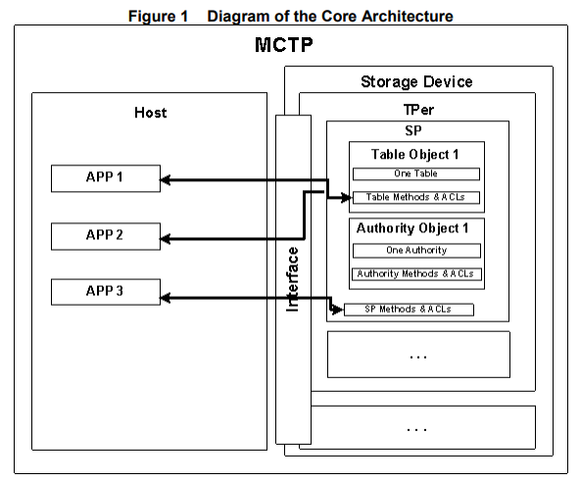
Trusted Storage Device Architecture Overview
Multicomponent Trusted Platform
supports 1 or more TPers
Trusted Peripheral
Security Provider
bilateral enrollment & connection
Data confidentiality and access control over TPer features and capabilities
Readable and writeable data areas
Built-in firmware/Hardware functions
SPs support functions such as
Authentication
Secured attribute-value storage
Disk encryption/decryption
Backup
Time stamping
Event logging
Tables & Table Content
Methods
Authorities
Access Control List &
Access Control Elements

Slide 8
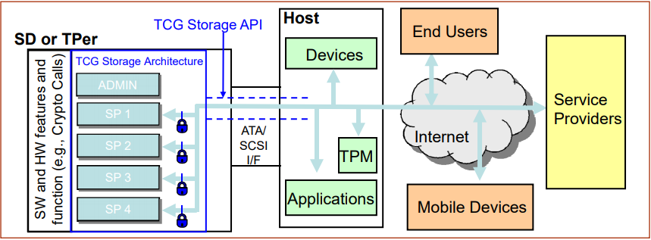
Trusted Storage Device Architecture Overview

Slide 9
Security Providers (SPs)
SPs are created by manufacturer & OEM
AND/OR Issuance SPs have its own storage, functional scope, and security domain
SP
Table
Method Name | ACL
Function 1 | User 4
Function 2 | User 1
Set | User 1
Get | User 2
A Security Provider is a set of tables and
methods that control the persistent trust state of the SP and MAY participate in control of the persistent
trust state of the TPer.
Tables. The two types of tables Byte table & Object table.
Table content is the persistent state information of the SP.
Methods. Method operations include functions such as: table additions, table deletion, table read access, and table backup.
Authorities specify passwords or cryptographic proofs required to become authenticated within a session to the SP.
Access Control Lists (ACLs) and Access
SP Method
ACL = user 1
Authorities
User 1
User 2
…

Slide 10
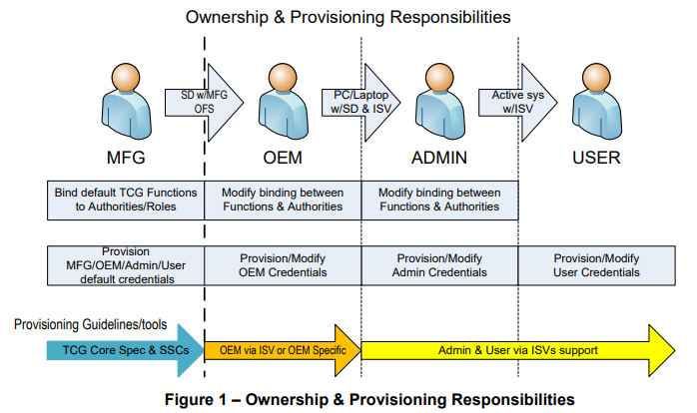
Ownership Overview
Manufacturer to define TCG functions are performed
Who has access to these functions
How the TPer and SPs communicate with the Host
When these events are permitted and when the events are logged.
SPs are created by the manufacturer during Storage Device creation, or through the Issuance process

Slide 11
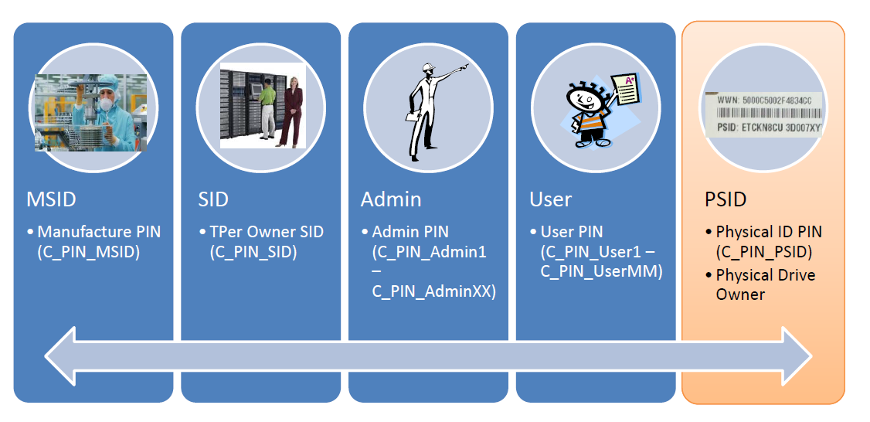
Ownership / Credentials

Slide 12
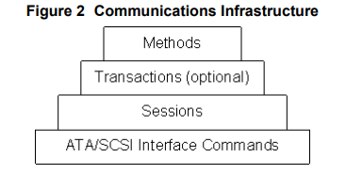
Host <--> TPer Communication Infrastructure
The only way to communicate with an SP is via a session.
Only the host is able to open a session.
Methods are invoked within sessions.
Trusted Command
(i.e. T10 SECURITY PROTOCOL IN/OUT
or T13 TRUSTED SEND/RECEIVE)
Host

Slide 13
MSID Credential
The MSID Credential value is set at manufacturing time by the storage device vendor and is typically printed on the storage device label. It represents the device's initial storage device SID Credential value (owner's password) and uses that value to authenticate to the SID authority in the Admin SP, and then change the SID from its default value.
The MSID Credential is a PIN credential that does not have an associated authority. Rather, the MSID is used to store a fixed PIN value that can be read over the interface by the host by anybody.

Slide 14
MSID Credential
Opal, Opalite and Pyrite SSCs borrow the concept of MSID from the Enterprise
Opal SSC 2.00 and subsequent versions introduced an additional option, to set the default SID credential to a Vendor Unique value other than MSID.

Slide 15

MSID Credential
The OEM includes trial security software for managing the SED, into which the user can opt.
Shipped to a PC/Notebook OEM.
The OEM integrates the SED into the PC/Notebook but does not execute any procedure to take ownership.
A user purchases this PC/Notebook and does not opt into the security software offering. The user may not be aware of, or may not care about, the security features offered. This user will use the PC/Notebook as if it contained a non-SED.
MFG manufactured an SED (Self-Encrypting Drives)
In this scenario, since neither the OEM nor the end user took steps to take ownership by changing the SID PIN, the value of the SID PIN will still be the same as the MSID Credential value and what is readable by anybody.

Slide 16
Section 2 Specification

Slide 17
Security Providers
SPs are created by manufacturer & OEM AND/OR Issuance
SPs have its own storage, functional scope, and security domain
A SPs is a set of tables and methods that control the persistent trust state of the SP and MAY participate in control of the persistent trust state of the TPer.

Slide 18
Table
Tables SHALL be stored in SP-specific parts of the secure storage area of the TPer. The SP-related secure storage area(s) of a TPer SHALL only be accessible via the host interface-specific IF-SEND and IF-RECV commands

Slide 19
Table
There are two kinds of tables : Byte Table & Object Table
Object tables provide storage for data that binds a set of methods and access controls to that data.
The address of the first row in a byte table is 0
Byte Table
Index | Column
0 | 0x00
1 | 0x30
2 | 0x40
…
n | 0x41
This column contains an 8-byte unique identifier for that row. Each row has an SP-wide unique value in this column
Object Table
UID | Column 1 | Column 2 | Column 3
8 byte UID 1 | Data | Data | Data
8 byte UID 2 | Data | Data | Data
… | … | … | …
Upon creation, the value of all cells in a byte table SHALL be 0x00, length is one byte
The columns of the object table define the contents of each object in it. And have same type

Slide 20
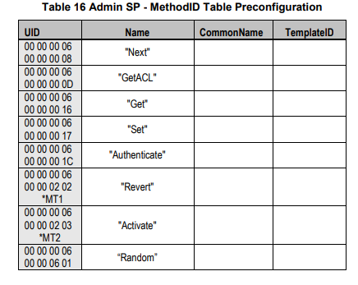
Method
Methods are remote procedure calls invoked by the host to manipulate SP state, methods operate on table or SP itself, and are used for session startup, authentication, table manipulation and access control customization.
Table Management
Table read/write
Authentication
Access Ctrl. Management

Slide 21
Method
A method invocation is made up of the following parts:
Header
InvokingID
MethodID
Parameter
Required parameters
Optional parameters
This is a list of the parameters submitted to the method. These parameters MAY be one of two types.
Send by Host
Generated & Response from TPer
This is the 8-byte UID of the table, object, or SP upon which the method is being invoked.
InvokingID.MethodID [parameters] ==> Method Result
This is the 8-byte UID of the method being invoked

Slide 22
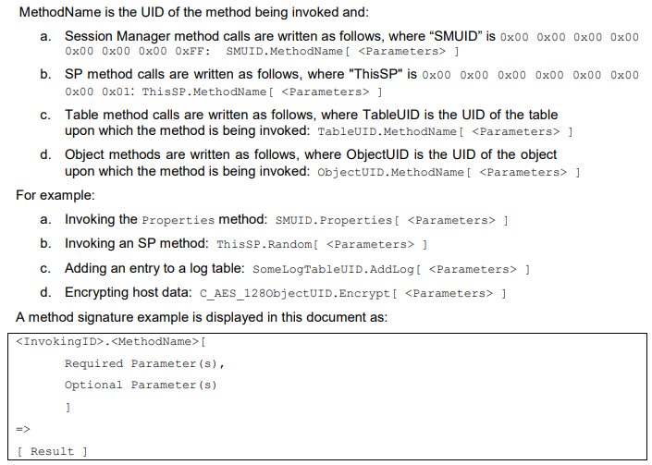
Method

Slide 23
Template
Base Template: Provides the tables and methods common for all SPs.
Admin Template: Provides administrative control over other SPs and the TPer settings as a whole, and control over Issuance of new SPs.
Clock Template: Contains tables and methods specialized for forensic and cryptographic clocks.
Crypto Template: Contains functional extensions to the Base SP cryptographic and procedural capabilities.
Locking Template: Provides tables and methods for storage encryption/decryption and read/write lock state control.
Log Template: Contains tables and methods specialized to forensic logging.
Templates are sets of tables & methods grouped by feature, from which SPs are built.

Slide 24
Template
The Base Template defines a common set of tables and methods, a subset of which SHALL be
incorporated into all SPs.
store an SP’s self-descriptive information, such as SP identification, size, and version numbers.
enable creation of tables, addition and deletion of rows to tables, and modification of table cell values.
Base Template
General Metadata Group
Credential Table Group
SP Method Group
Method Manipulation Group
SPInfo
C_PIN
C_EC_384
define available encryption/decryption algorithms and authentication mechanisms, and also store associated secrets or keys.
DeleteSP
DeleteMethod
SPTemplates
C_RSA_1024
C_EC_521
Access Control Metadata Group
C_RSA_2048
C_EC_163
Basic Table Method Group
ACE
C_EC_233
CreateTable
Set
C_AES_128
Authority
Delete
Next
C_AES_256
C_EC_283
Certificates
CreateRow
GetFreeSpace
C_EC_160
C_HMAC_160
DeleteRow
GetFreeRow
Table and Method Metadata Group
C_EC_192
C_HMAC_256
Get
Table
C_EC_224
C_HMAC_384
Column
C_EC_256
C_HMAC_512
Access Control Method Group
Key Related Method Group
Type
define which authorities are permitted to successfully invoke which methods and modify ACLs
Authenticate
GenKey
MethodID
GetACL
GetPackage
define authorities, the secrets and authentication methods those authorities require, and the access control associations that permit method operation.
store data about the tables and methods that make up this SP.
AccessControl
AddACE
SetPackage
SecretProtect
RemoveACE

Slide 25
Template
Admin Template
The purpose of the Admin Template is to provide to the Admin SP the capability to optionally issue additional SPs and to maintain information about the TPer.
Tables
Methods
SPs on the TPer Group
Method
SP
IssueSP
TPer Metadata Group
TPerInfo
Serial Number Contents
CryptoSuite

Slide 26
Template
Clock Template
The Clock Template enables an SP to manage information about time.
Tables
Methods
Methods
ClockTime
GetClock
ResetClock
SetClockHigh
SetLagLow
Tern such as :
ExactTime, HighTime, High Trust, IncrementalClock, LagTime, Low Time, Low Trust, MonotonicTime, MonotonicIncrement & Timer Mode
SetLagHigh
SetClockLow
IncrementCounter

Slide 27
Template
Crypto Template
The Crypto Template provides a set of cryptographic methods that operate on public and symmetric key store tables, collectively called Credential tables, provided by the Base and other Templates. The Crypto Template also provides a set of tables that supports these methods that enable host invoked cryptographic operations with host-supplied data to occur in the SD.
Tables
Methods
Hash Method Group
Decryption Method Group
Encryption Method Group
Cryptographic Support Group
HashInit
DecryptInit
EncryptInit
H_SHA_1
Hash
EncryptFinalize
DecryptFinalize
H_SHA_256
Decrypt
HashFinalize
H_SHA_384
Encrypt
H_SHA_512
HMAC Method Group
Method
Random Number Related Method Group
HMACInit
XOR
HMAC
Random
HMACFinalize
Sign
Stir
H_SHA_512
Verify

Slide 28
Template
Locking Template
The Locking Template defines mechanisms for access control to user data (LBA), including controlling media encryption, user data encryption key management, and Read/Write lock state.
Side effects occur when writing cells of the tables of the SP that incorporates the Locking Template. These side effects include enabling Read/Write locking, enabling encryption with a certain encryptionkey, and initiating the re-encryption process.
Tables
Tables
Media Encryption Key Table Group
LockingInfo
K_AES_128
Locking
K_AES_256
MBRControl
MBR

Slide 29
Template
Log Template
The Log Template is designed to maintain a log of the activities on the SP into which it was issued. The purpose of providing this service is to aid in audits, forensic analysis, and general monitoring of the operation of the SP.
Tables
Methods
Table
Methods
Log
AddLog
LogList
CreateLog
ClearLog
FlushLog

Slide 30
Access Control
Access control limits the methods that are able to be processed on an SP, a table, or on specific rows and columns of a table.
Access Control setting are configurable and assignable
Permission to process a method is governed by which secrets the method’s invoker has proven that it knows. The secrets and their public parts are called Credentials. The operation for proving knowledge of a secret is called an Authentication Operation.
An authority is used by the host application to represent a person, a role, a program agent, etc. These are distinctions of meaning to the application, not to the SP.

Slide 31
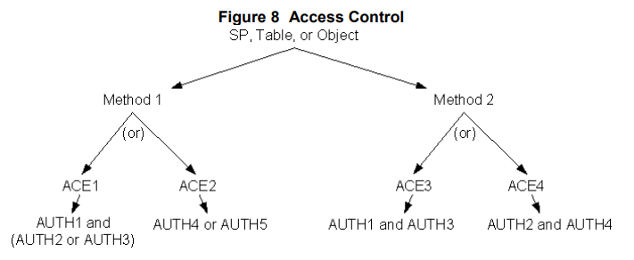
Access Control
Access Control is specified in layers. The top layer of the mechanism is Access Control Lists (ACLs). ACLs are lists of Access Control Elements (ACEs).
Look up ACLs

Slide 32
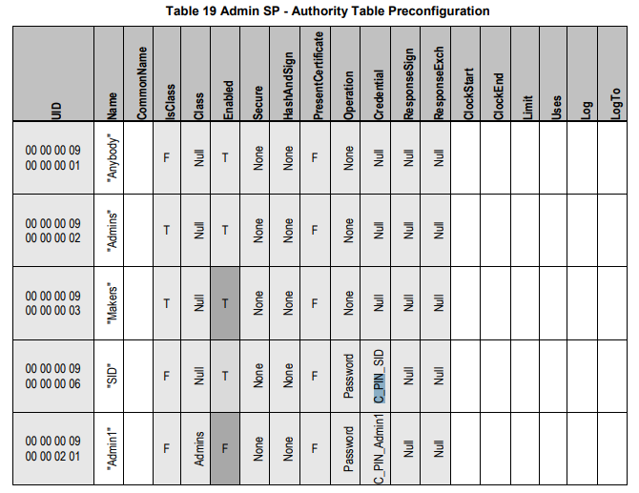
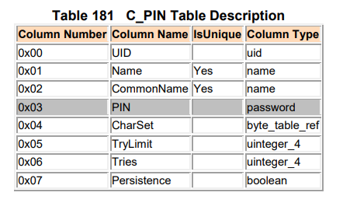
Access Control -- authority
Authentication Credential
Authentication Operation
Required
Credential Table (C_*)
Store authentication secrets

Slide 33
Access Control -- SP Issuance
Issuance is the cryptographically controlled creation of SPs from templates. Issuance occurs within a session to a TPer's Admin SP, and is achieved by demonstrating knowledge of the secrets required to authorize the creation of new SPs and then, for each new SP, creating a unique credential for the Admin authority on that SP.

Slide 34
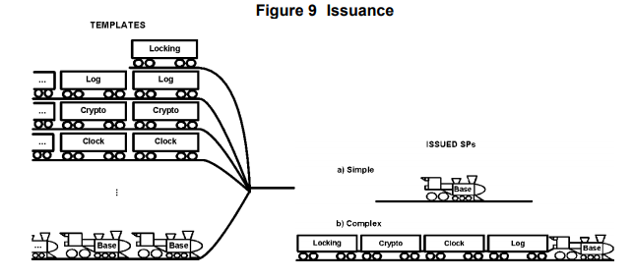
Access Control -- SP Issuance
Additional cars (other Templates) providing additional capabilities are able to be added at the time of issuance
Every train (SP) must have an engine (Base Template)

Slide 35
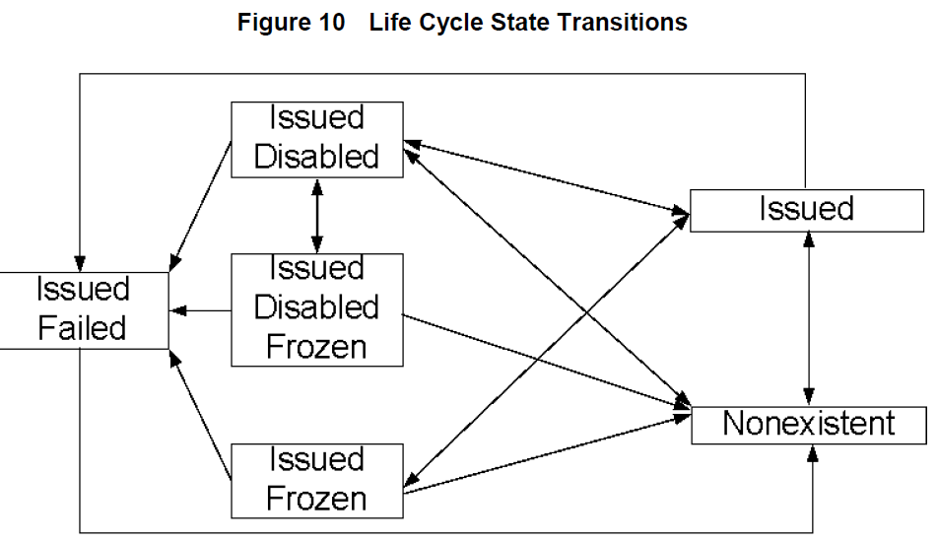
Access Control -- SP Issuance

Slide 36
Access Control -- Personalization
Personalization follows Issuance.
The Admin each authority on the new SP accomplishes personalization by opening a session to the issued SP, creating new tables (in addition to the tables that were provided by the templates), provisioning those tables, creating and configuring new authorities, and setting the access controls on the SP's methods.
'
'
'

Slide 37
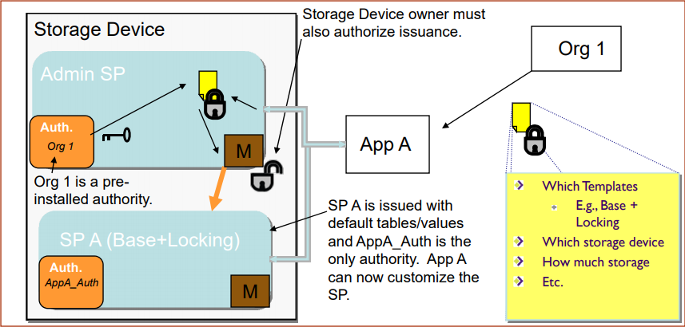
Access Control – Issuance / Personalization
'
'
'

Slide 38
Section 3 TCG OPAL

Slide 39
Opal Overview
SECURITY PROVIDERS
Admin SP
Locking SP
INTERFACE COMMUNICATION PROTOCOL
Support LV0 Discovery
CRYPTOGRAPHIC FEATURES
Full Disk Encryption (AES-128 & 256)
AUTHENTICATION
MANDATORY FEATURE SETS
Additional DataStore Tables
PSID
'

Slide 40
Opal SSC Feature Set: Additional DataStore Tables
The DataStore is a byte table. It can be used by the host for generic secure data storage
To provide an ability to store application-specific metadata in the TPer in such a way that:
• It is possible to create multiple DataStore tables independent from each other
• It is possible to configure access control in such a way that multiple entities owning DataStore tables but unaware of each other are prevented from accessing each other’s data
• The storage area of the DataStore tables does not overlap with the User Area in order to avoid potential compatibility issues with existing host software

Slide 41
Opal SSC Feature Set: PSID
Define an authority/credential pair whose C_PIN object’s PIN column value is not discoverable via the interface.
Provide access control settings that permit invocation of the Revert method if the PSID authority has been successfully authenticated.

Slide 42
Opal SSC-Specific Methods
Activate -- Admin Template SP Object Method
Revert -- Admin Template SP Object Method
RevertSP -- Base Template SP Method

Slide 43
Opal SSC-Specific Methods
Activate
managing the life cycle of SPs created in manufacturing, whose initial life cycle state is “Manufactured-Inactive”.
(Manufactured-Inactive→Manufactured) state.

Slide 44
Opal SSC-Specific Methods
Revert
Invoking Revert on an SP object causes the SP to revert to its Original Factory State. TPer owner to remove the SP owner’s ownership of the SP.

Slide 45
Opal SSC-Specific Methods
RevertSP
Invoking RevertSP on an SP SHALL cause it to revert to its Original Factory State. This method allows the SP owner to relinquish control of the SP and revert the SP to its Original Factory State.

Slide 46
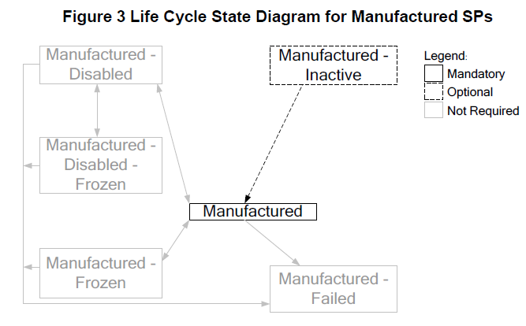
Life Cycle
If the Locking SP is a Manufactured SP, support of the Manufactured state is mandatory and support of the Manufactured-Inactive state is optional for the Locking SP.
The Original Factory State of the Admin SP SHALL be Manufactured. The only state that is mandatory for the Admin SP is Manufactured.

Slide 47
Manufactured SP Life Cycle States
Manufactured-Inactive
Activate method
Manufactured
Current SID PIN (C_PIN_SID)
(C_PIN_Admin1)
ORIGINAL FACTORY STATE
Revert or RevertSP
Any State

Slide 48
The End
Thank You

